Slide 1
Youtube Viral Predictor
Rainey Chak, John Solo, Suofei Feng, Yen-Ming Huang

Slide 2
Project Scope
Problem (What): Design and develop a tool that forecasts how popular a Youtube video will be
User (Why): To plan the topic of their next or first video
Solution:
Youtube Viral Predictor:
Allows user to understand what are trending topics and what will be a popular video topic

Slide 3
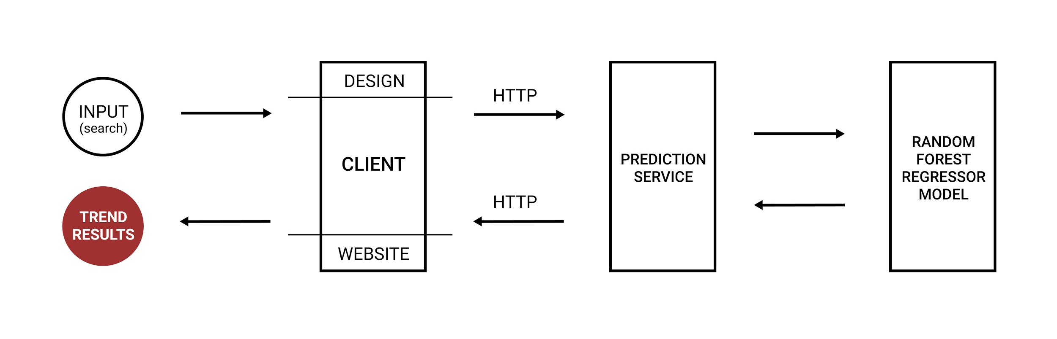
Architectural Diagram

Slide 4
My Contributions
User Persona and Mockup
Figma Link: https://www.figma.com/file/nF5BeBvjdb8CNtnJu7krMV/Youtube-Viral-Generator?node-id=0%3A1

Slide 5
Next Steps
Predict how long a video will take to trend
Show user what categories to put their videos under
Expand to support more languages globally

